Slide 1


M.Tech Program
Advanced Industry Integrated Programs
Jointly offered by University and LTIMindTree
Project Title
RAG for Secure Enterprise Document Intelligence Using Role-Based Access Control (RBAC)
Team Member
VINOTH KANNA S
CRESCENT 2025-27
Knowledge partner | Implementation partner

Slide 2

RAG for Secure Enterprise Document Intelligence Using Role-Based Access Control (RBAC)
Introduction
Enterprise documents vary widely in sensitivity across departments.
RAG grounds LLM answers in real documents, reducing hallucination.
Most RAG systems ignore who is asking — a security gap.
This project enforces RBAC inside the retrieval pipeline itself.

Slide 3
RAG for Secure Enterprise Document Intelligence Using Role-Based Access Control (RBAC)
Objective
Enforce RBAC at the retrieval layer, not just the UI.
Block unauthorized chunks from ever reaching the LLM.
Give admins tools to manage users and audit logins.
Deliver a working full-stack demo with real authentication.

Slide 4
RAG for Secure Enterprise Document Intelligence Using Role-Based Access Control (RBAC)
Modules to cover
Data Ingestion & Chunking
Vector Database & Embedding Storage
1
2
RBAC Policy Engine
Secure Authentication
3
4
RBAC-Filtered Retrieval
RAG Answer Generation
5
6
Admin & Audit Module
Web Frontend (Node.js)
7
8

Slide 5
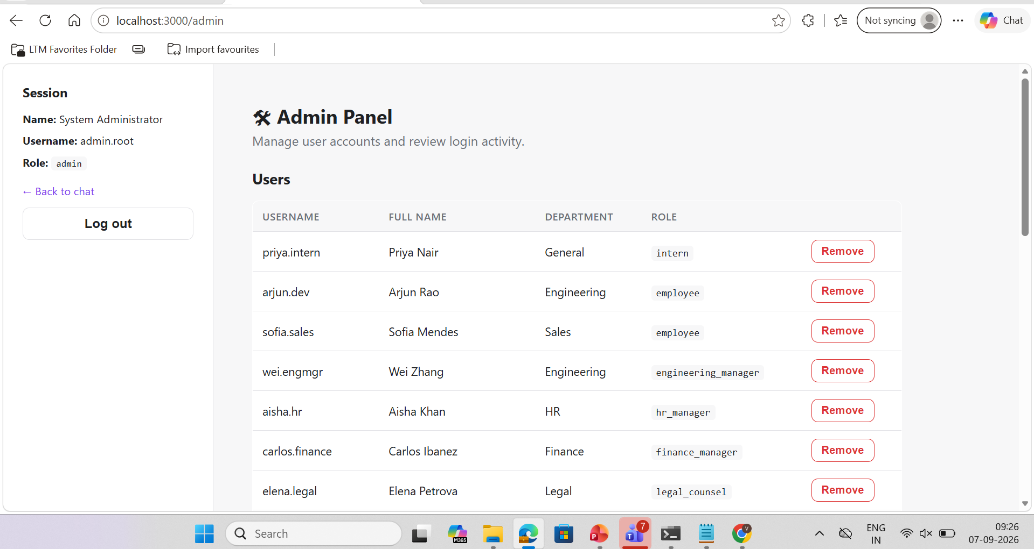
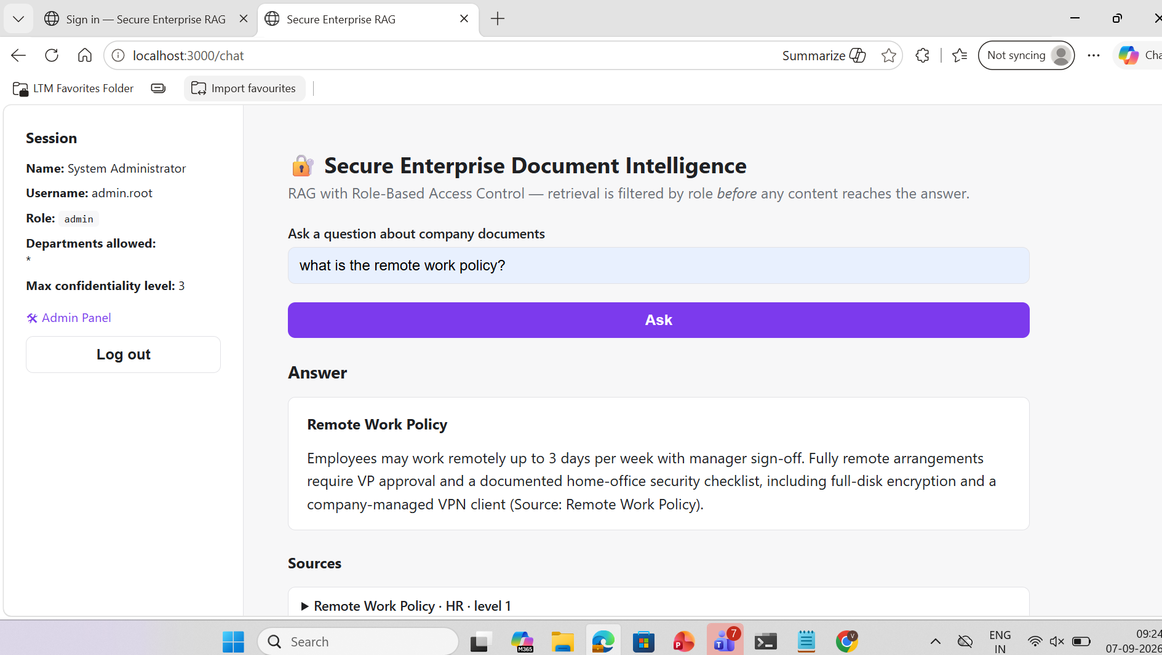
Frontend

Slide 6
Methodology / Modeling Plan
Adopt a Retrieval-Augmented Generation (RAG) approach: retrieve relevant document chunks before generating an answer, rather than relying on the LLM's parametric memory alone.
Layer Role-Based Access Control (RBAC) directly into the retrieval step, so access is enforced before generation, not after.
Build the system incrementally: ingestion → RBAC-filtered retrieval → answer generation → authentication → admin controls → UI upload — each module tested independently before integration.
Use a defense-in-depth model: enforce access rules at the database query level and re-verify them in application code, so no single point of failure can leak data.
Validate the system empirically by testing the same query across multiple user roles and confirming that responses differ correctly based on access rights.

Slide 7
Data Preprocessing
Source documents are synthetic enterprise text files (policies, reports, memos) tagged with department and confidentiality level, plus user-uploaded files (.txt, .md, .csv, .json, .docx, .pdf).
Text extraction: plain text read directly; .docx parsed via XML extraction; .pdf parsed via pypdf.
Documents are chunked using a sliding-window character splitter (500-character chunks, 80-character overlap) to preserve context across chunk boundaries.
Each chunk retains its parent document's metadata — department and confidentiality level — so access control can be applied at the chunk level, not just the document level.
Chunks are embedded locally using a sentence-transformer model (all-MiniLM-L6-v2), requiring no external API call for this step.

Slide 8
Approach / Algorithms / Tools
Embeddings: Sentence-Transformers (all-MiniLM-L6-v2) for local, free semantic vector generation.
Vector storage & search: ChromaDB, with metadata filtering (department, confidentiality level) applied at query time.
Access control algorithm: rule-based RBAC — a role is granted access only if both its allowed-department set and its confidentiality ceiling are satisfied.
Answer generation: Groq API (Llama/GPT-OSS models) for grounded LLM responses; falls back to extractive answers (raw retrieved chunks) when no API key is configured.
Authentication: PBKDF2-HMAC-SHA256 password hashing (200,000 iterations, per-user salt); OTP-based password reset (SHA-256 hashed, 10-minute expiry).
Backend: Python, FastAPI (REST API layer).
Frontend: Node.js, Express (server-rendered pages, session-based auth via HTTP-only cookies).

Slide 9
Project Plan / Milestones Progress
Milestone 1 — Core RAG pipeline: document ingestion, chunking, embedding, and vector storage. Completed.
Milestone 2 — RBAC engine: role/department/confidentiality model and access-check logic. Completed.
Milestone 3 — RBAC-filtered retrieval: two-layer enforcement (database filter + application-level re-check). Completed.
Milestone 4 — Authentication system: secure login, session tokens, password hashing. Completed.
Milestone 5 — Full-stack interface: Node.js frontend with login, chat, and admin pages, connected to a FastAPI backend. Completed.
Milestone 6 — Admin & account management: user creation/removal, account enable/disable, login audit log with CSV export. Completed.
Milestone 7 — Account recovery: OTP-based forgot-password flow with email delivery (and a demo-mode fallback). Completed.
Milestone 8 — Document upload: in-UI upload with immediate indexing, permission-scoped to each role. Completed.
Milestone 9 — Deployment: containerized deployment to Railway with persistent storage. In progress.

Slide 10
Pipeline Structure
Step 1 — Authentication: user submits username + password → verified against a salted PBKDF2 hash → session token issued.
Step 2 — Query submission: authenticated user submits a natural-language question through the chat interface.
Step 3 — Embedding: the question is embedded using the same sentence-transformer model used for document chunks.
Step 4 — RBAC-filtered vector search: ChromaDB is queried with a metadata filter restricting results to the user's allowed departments and confidentiality ceiling.
Step 5 — Post-filter verification: returned chunks are re-checked in application code against the same access rules before proceeding.
Step 6 — Answer generation: approved chunks are passed to the LLM (Groq) with instructions to answer only from the given context and cite sources; falls back to extractive display if no LLM is configured.
Step 7 — Response delivery: the answer, its sources, and a count of any withheld (access-denied) results are returned to the user interface.
Step 8 — Audit logging: the query, user, and retrieval outcome are recorded for administrative review.

Slide 11
RAG for Secure Enterprise Document Intelligence Using Role-Based Access Control (RBAC)
1. Data Ingestion & Chunking
Document Loading, Cleaning, and Segmentation
  Synthetic enterprise documents are generated across departments and confidentiality levels. Each document is split into overlapping character-based chunks, and every chunk retains metadata linking it back to its department and confidentiality level for later access control.

Slide 12
RAG for Secure Enterprise Document Intelligence Using Role-Based Access Control (RBAC)
2. Vector Database & Embedding Storage
ChromaDB with Metadata-Tagged Embeddings
  Each chunk is embedded using a local sentence-transformer model and stored in a persistent ChromaDB collection. Every embedding is stored alongside department and confidentiality metadata, enabling metadata-based filtering during search.

Slide 13
RAG for Secure Enterprise Document Intelligence Using Role-Based Access Control (RBAC)
3. RBAC Policy Engine
Roles, Departments, and Confidentiality Levels
  Nine roles, from Intern to Admin, are mapped to allowed departments and a maximum confidentiality ceiling. Access is granted only when both the department check and the confidentiality check pass, mirroring real enterprise access models.

Slide 14
RAG for Secure Enterprise Document Intelligence Using Role-Based Access Control (RBAC)
4. Secure Authentication
Salted Password Hashing & Session Tokens
  Salted Password Hashing & Session TokensUser credentials are verified using PBKDF2-HMAC-SHA256 with a unique salt per user. A successful login issues a time-limited session token, and every login attempt — successful or failed — is recorded in an audit log.

Slide 15
RAG for Secure Enterprise Document Intelligence Using Role-Based Access Control (RBAC)
5. RBAC-Filtered Retrieval
Two-Layer Access Enforcement
  A user's query is filtered at the database level using a metadata WHERE clause, then re-checked in application code before any chunk reaches the language model. This defense-in-depth approach keeps unauthorized content out even if one layer is misconfigured.

Slide 16
RAG for Secure Enterprise Document Intelligence Using Role-Based Access Control (RBAC)
6. RAG Answer Generation
Grounded LLM Responses
  Only RBAC-approved chunks are passed to the language model, which is instructed to answer strictly from the provided context and cite sources. When no API key is configured, the system falls back to an extractive answer built directly from the retrieved chunks.

Slide 17
RAG for Secure Enterprise Document Intelligence Using Role-Based Access Control (RBAC)
7. Admin & Audit Module
User Management and Login Monitoring
  Administrators can add or remove user accounts and assign roles through a dedicated panel. Every login attempt is logged with timestamp, username, result, and IP address, and the full history can be exported as a CSV file.

Slide 18
RAG for Secure Enterprise Document Intelligence Using Role-Based Access Control (RBAC)
8. Web Frontend (Node.js)
Express-Based User Interface
  A Node.js/Express server provides login, chat, and admin pages, proxying requests to the Python backend while keeping session tokens server-side. Answers render with Markdown formatting, and each source document displays its department and confidentiality label.

Slide 19
M.Tech Program
Advanced Industry Integrated Programs
Jointly offered by University and LTIMindTree
Project Title
Agentic AI Multi-Agent Architecture for Automated Fake News Verification & Explainable Trust Assessment
Team Member
VINOTH KANNA S
CRESCENT 2025-27
Knowledge partner | Implementation partner

Slide 20
Agentic AI Multi-Agent Architecture for Automated Fake News Verification
Introduction
Fake news spreads rapidly through social media and digital platforms.
Traditional fact-checking is slow and difficult to scale.
Existing AI models often give results without clear reasoning.
This project uses Agentic AI to verify claims, collect evidence, and provide an explainable trust score.

Slide 21
Agentic AI Multi-Agent Architecture for Automated Fake News Verification
Objective
Build a Multi-Agent System – Use Claim Extraction Agent, Evidence Retrieval Agent, Source Credibility Agent, Cross-Reference Agent, and Verdict Agent for automated fact-checking.
Verify Claims – Analyze evidence and source credibility through cross-checking.
Generate Trust Scores – Provide explainable trust scores with confidence levels.
Reduce Bias & Ensure Auditability – Use self-checking and maintain an evidence trail.

Slide 22
Agentic AI Multi-Agent Architecture for Automated Fake News Verification
Modules to cover
Module Name | Subtopic
Claim Extraction Module | Parsing input into atomic, checkable claims; separating fact from opinion; detecting implicit/misleading framing
Context & Provenance Module | Tracing content origin, publisher history, reverse-image/video matching, manipulation detection
Evidence Retrieval Module | Querying search engines and fact-check databases per claim; retrieving both supporting and contradicting evidence
Source Credibility Module | Scoring sources on accuracy track record, editorial transparency, and domain reputation
Cross-Referencing Module | Comparing claims against evidence; classifying support/contradict/unverifiable; detecting logical fallacies
Linguistic & Behavioral Signal Module | Detecting emotional manipulation, clickbait, false urgency as supplementary risk indicators
Adversarial Review Module | Devil's-advocate agent that challenges the draft conclusion to surface weak reasoning
Trust Aggregation Module | Combining all signals via a transparent weighted rubric into a final trust score with confidence interval
Explainability & Reporting Module | Generating human-readable rationale, evidence citations, and audit trail for every verdict

Slide 23
Methodology
1
Evidence Over Assertion
2
Specialized Agents
The pipeline never guesses truth directly. It gathers real, citable evidence from independent sources and scores that evidence instead.
Each pipeline stage - ingestion, search, scoring, explanation - is an independent, single-purpose agent with its own inputs, outputs, and failure handling.
3
Transparent, Weighted Rubric
4
Explainable by Design
A composite 0-100 Trust Score is built from four weighted factors: Source Evidence (40%), Content Consistency (25%), Media Authenticity (20%), Fact-Check Alignment (15%).
Every verdict ships with its factor breakdown, matched sources, and a plain-language AI summary - never a bare true/false label.

Slide 24
Approach, Algorithms & Tools
1
Agents & Algorithms
2
External Data Sources
3
Core Tech Stack
IngestionAgent
Text / URL / audio parsing + claim extraction
SerpAPI
Google Fact Check engine + web fallback
Backend
FastAPI, SQLAlchemy, SQLite, JWT auth, rate limiting
SearchAgent
Parallel multi-source retrieval, de-dup & trusted-source ranking
NewsAPI + GNews
Two independent news search providers
Orchestration
Python asyncio - agents run concurrently, not in series
AudioAnalysisAgent
Caption & object detection; transcription + confidence signals
Wikipedia
General web & background evidence
Frontend
React, TypeScript, Tailwind CSS
TrustScoringAgent
Weighted rubric -> 0-100 score & verdict
HuggingFace (optional)
Image captioning & object detection
Voice Input
Web Speech API (speak-to-search)
ExplanationAgent
LLM-generated summary & recommendations
AssemblyAI
Audio transcription
Export
Server-rendered PDF verification reports
Groq (Llama 3.3 70B)
Narrative summarization

Slide 25
Pipeline Structure
Input
Text · URL · Image · Audio
IngestionAgent
Extract text & candidate claims
Audio Analysis Agent
Runs only for audio input
SearchAgent
SerpAPI · NewsAPI · GNews · Wikipedia (parallel)
TrustScoringAgent
Weighted rubric -> Trust Score + Verdict
ExplanationAgent
Groq LLM -> summary + recommendations
Result
Saved to SQLite - rendered as score, factors & sources

Slide 26
Agentic AI Multi-Agent Architecture for Automated Fake News Verification
Project Plan: Milestones & Progress
Phase 1 - Core Verification Pipeline COMPLETED
✓
Ingestion, Search, Trust Scoring & Explanation agents; end-to-end text/URL verification with a transparent factor breakdown.
Phase 2 - Multi-Modal & Accounts COMPLETED
✓
Image & audio verification, JWT auth with guest mode, history dashboard, PDF report export.
Phase 3 - Data Completeness Fixes COMPLETED
✓
Media-analysis findings & AI summary reliably surfaced in the UI; voice ("speak-to-search") input.
Phase 4 - Evidence Quality Upgrade COMPLETED
✓
Second independent news source (GNews), 20-outlet trusted-publisher prioritization, "Detected Source" attribution UI, automatic DB migrations.
Phase 5 - Planned Next PLANNED
Broader fact-check/language coverage, production deployment, and structured user testing.

Slide 27
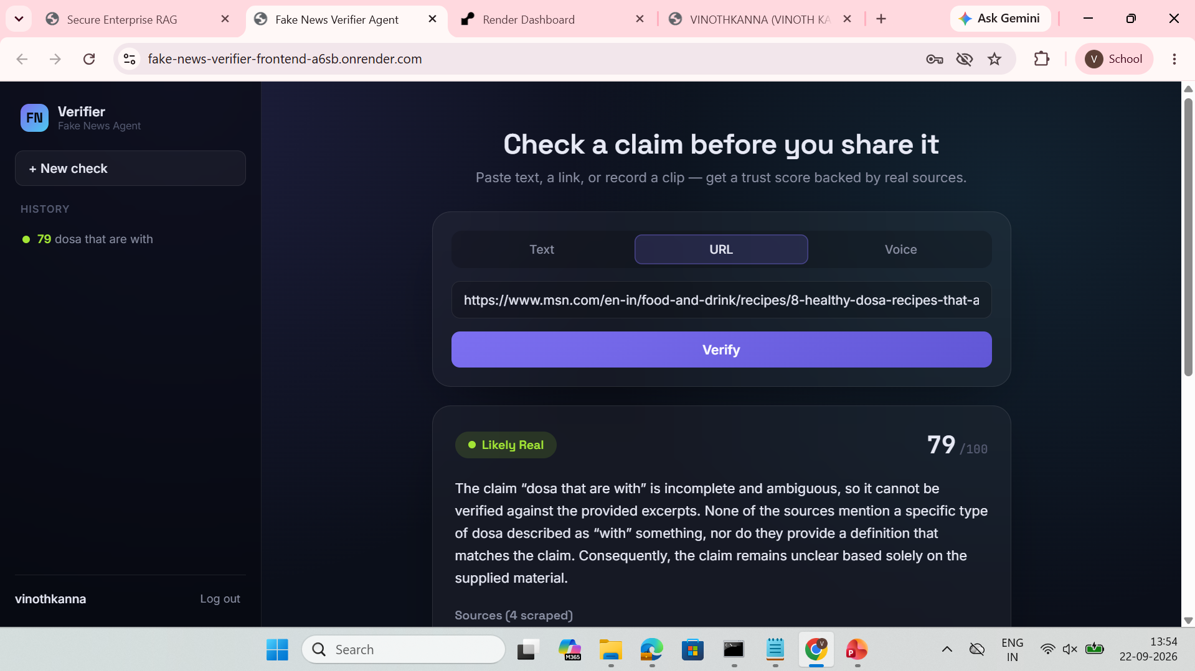
Result: Under Testing

